Slide 1
Estimation of parameters of Kumaraswamy Exponential Distribution and Gamma-Gompertz Distribution
By Shreyansh Sinha (200955)
Under the guidance of Prof. Debasis Kundu (MTH) and Prof. Raghunandan Sengupta (IME)

Slide 2
Content
What is Reliability Theory and Competing Risk Model
KUM-G Distributions
Gamma-Gompertz Distribution
Proposed Models
Results
Further Scope
References

Slide 3
What is Reliability Theory
Reliability Theory or Survival analysis is a branch of statistics for analyzing the expected duration of time until one event occurs, such as death in biological organisms and failure in mechanical systems.
Parametric survival analysis involves modeling the data based on a known distribution like Weibull, Lognormal, etc and finding the different parameters associated with the distribution.

Slide 4
Competing Risk Setup
A competing-risk model refers to a situation where a system (or organism) is exposed to two or more causes of failure (or death) but its eventual failure (or death) can be attributed to exactly one of the causes of failure.
The causes can follow similar or different distribution and our main task is to determine the combined distribution or survival function of the system(organism).
ailure time of all the

Slide 5
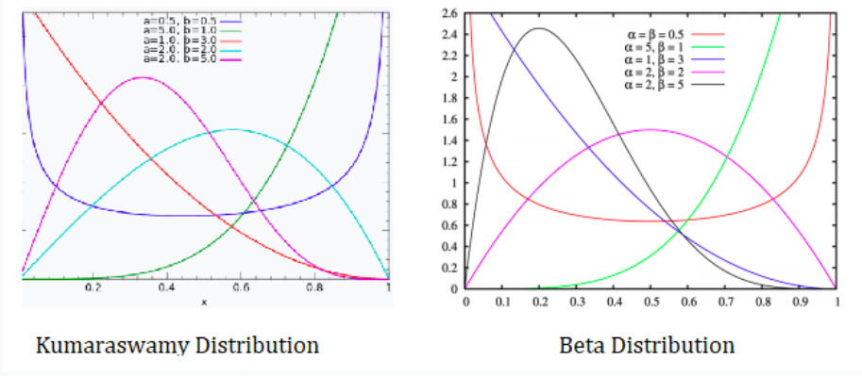
Kumaraswamy Distribution:-
The Kumaraswamy distribution is a two-variable family of distributions that is bounded at one and zero. Its CDF and PDF respectively are:-
F(x) = 1 − (1 − Xª)^{b}
f(x) = abx^{a−1}(1 − xª)^{b−1.} (a and b are non negative shape parameters)
The Kumaraswamy distribution is very similar to the beta distribution and has the same basic shape. So similar in fact, it’s often referred to as a “Beta- like” distribution. However, the Kumaraswamy distribution is simpler to use and in some situations more tractable. It is often preferred over the Beta in part because the CDF has the closed form.
Comparing the shape of beta and Kumaraswamy distribution for different values of parameters

Slide 6
Kumaraswamy-G Function :-
Jones (2009) highlighted several advantages of the Kumaraswamy distribution over the beta distribution: the normalizing constant is very simple, simple explicit formulae for the distribution and quantile functions which do not involve any special functions and a simple formula for random variate generation. If G denotes the cdf of a random variable, Cordeiro and de Castro (2011) defined the Kum-G distribution by:-
Cdf:- F (t) = 1 − [1 − Gª(t)]^{b} , t > 0 (a and b are non negative shape parameters)
The probability density function (pdf) is:-
f(t) = abg(t)G^{a−1}(t)[1 − Gª(t)]^{b−1} (where g(t) = dG(t)/dt )
Kumaraswamy Exponential Distribution:- The cdf of the Kumaraswamy exponential distribution are:-
F_{EK} (X;α,β,γ) = [1−(1−X^{α})^{β}]^{γ}, x ∈ (0,1)
where α is scale parameter and β, γ are positive shape parameters

Slide 7
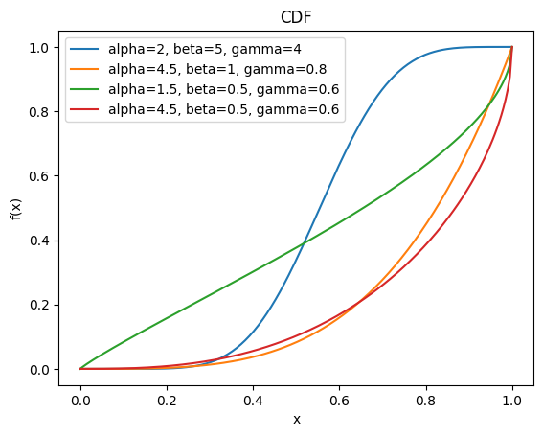
Kum-G Function :-
CDF of Kumaraswamy Exponential Distribution for different values of parameters

Slide 8
The Gamma-Gompertz Distribution :-
Gompertz Distribution:- The Gompertz distribution is a probability distribution commonly used in survival analysis. Its probability density function (PDF) of the Gompertz distribution is given by:-
F(x) = αβe^{αx}e^{−βk} where k is e^{αx} -1 ( where α>0 is shape parameter and β>0 is scale)
Gompertz distribution (abbreviated as Go) plays an important role in many real life applications, especially for right and left skewed data. This is one of the most well-known distribution based on mortality laws. The Go has only monotone hazard function, but in applied sciences non-monotonic hazard function may be taken into account such as bathtub shaped hazard function. For this reason, several generalization of Go have been constructed. We introduce the GGo distribution as one such generalisation:-
Gamma-Gompertz Distribution (GGo) :- A random variable X follows GGo distribution if the cdf and pdf are defined as:-
Where γ is the lower incomplete gamma function and Γ is the gamma function
G(x) = γ(θ, λ(e^{αx} − 1)/α) /Γ(θ)

Slide 9
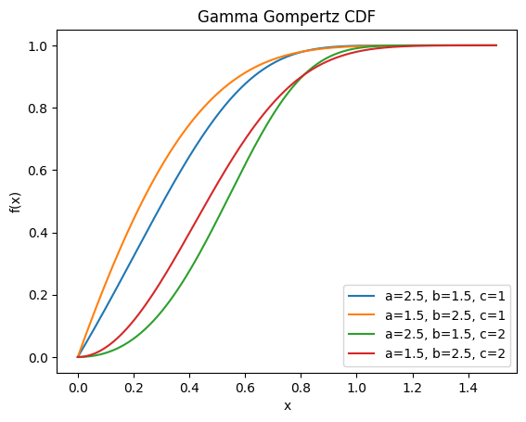
The Gamma-Gompertz Distribution :-
CDF of Gamma-Gompertz Distribution for different values of parameters

Slide 10
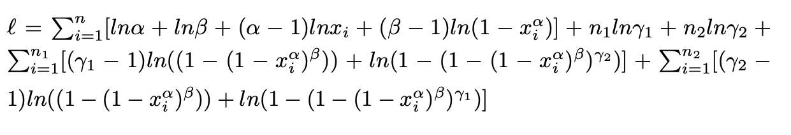
Models
2-competing risk Kumaraswamy exponential
We setup a 2-competing risk model where both the risk follow Kumaraswamy exponential distribution with different γ or scale factor. Hence, the resultant will be a 4 parameter distribution.
We estimate the parameter for the above model using MLE equations for a given data. The log-likelihood equation for the same is:-
To find the MLE we partially differentiate w.r.t each parameter and set it to 0. Clearly, no close form solution for the MLE equations and we must use numerical methods to solve the MLE equations.

Slide 11
Models​
Algorithm to find the MLE for the model is as follows:-
1.Sampling:-
Create a sample of N points (10⁶, in this case) from the Kumaraswamy Exponential distribution for some parameter values.
We use Inverse Sampling technique, calculating the inverse quantile function and using it to generate samples from the distribution
2.Bootstrapping and MLE calculation :-
We employ Bootstrapping where smaller set of samples (of size n), is taken without replacement and the MLE is calculated for them. (say θ_{i}ˆ)
We repeat the process for different smaller samples of size n for B times (here B represent the times we bootstrapped the data)
We have taken 3 different values for n namely 20, 50 and 100 and corresponding to them the values of are B= 5*10⁴ ,2*10⁴ and 10⁴ respectively.

Slide 12
Models​
3.Result calculation :-​
The values of MLE from each iteration is stored in an array.
The average of this array is taken as the estimated value for our set of parameters
Variance is also calculated for the estimated parameter.
Bayesian Estimation of Gamma-Gompertz Distribution
We are utilizing Bayesian analysis to estimate the parameters of the Gamma Gompertz distribution for a given data set.​
​
On of the major task is to determine the prior for the parameters and as all the 3 parameters are non-negative hence, we can take a prior which has only positive support. In this model, we use three different priors for the parameters namely, gamma, exponential and uniform and calculate the mean of the posterior which will be our estimate of the parameters.

Slide 13
Models​​
Algorithm to find the parameters are as :-
1.Sampling
Create a sample of N points (10⁴, in this case) from the distribution for some parameter values
We Utilize the Metropolis Hasting algorithm to sample from the data, taking standard normal distribution as our proposal distribution.
2. Calculating Posterior
Prior distribution for the parameters is selected from the three distributions (gamma, exponential and uniform) .
Posterior distribution is defined as the product of the prior and likelihood (or, log(posterior) = log(prior)+ log(likelihood), using this posterior is calculated.
As the close form of the posterior don't exist, we use Metropolis Hasting Algorithm to sample from the posterior distribution, and the mean of the drawn points is calculated.
3. Results
Now by Central Limit Theorem, we can say that the sample mean tends towards the distribution mean which is our estimate for the parameters.
Variance of posterior distribution is calculated as well as Confidence Interval are calculated, to check the quality of our estimate.

Slide 14
Results
2-Competing Risk Kumaraswamy Exponential Distribution MLE:-
n | αˆ | βˆ | γ₁ˆ | γ₂ˆ | Var(αˆ ) | Var(βˆ ) | Var(γ₁ˆ ) | Var(γ₂ˆ )
20 | 0.7452 | 0.4861 | 1.9748 | 2.881 | 0.2759 | 0.1996 | 0.2266 | 0.0741
50 | 0.8050 | 0.5734 | 2.0041 | 2.8968 | 0.2748 | 0.2474 | 0.24927 | 0.0590
100 | 0.8050 | 0.5734 | 2.0041 | 2.8968 | 0.2748 | 0.2474 | 0.24927 | 0.0590
Table 1: α=0.5, β=0.5, γ_{1.}= 2 and γ₂ = 3
n | αˆ | βˆ | γ₁ˆ | γ₂ˆ | Var(αˆ ) | Var(βˆ ) | Var(γ₁ˆ ) | Var(γ₂ˆ )
20 | 1.0304 | 1.2513 | 1.6878 | 2.5177 | 0.8672 | 3.6430 | 2.0415 | 2.9507
50 | 1.1076 | 1.5940 | 1.2634 | 1.8422 | 0.3877 | 2.5238 | 0.6407 | 0.8439
100 | 0.9078 | 0.9078 | 1.0014 | 1.7037 | 0.2164 | 1.9010 | 0.4874 | 0.4223
Table 2: α=0.5, β=0.5, γ1.= 1 and γ2 = 2
Here, n represents the number of points taken out of sample to calculate the MLE, αˆ, βˆ, γˆ and γˆ denote the values of the MLE estimates, whereas var(αˆ), var(βˆ), var(γ₁ˆ ) and var(γ₂ˆ ) denote the Error/ Variance of these parameters.

Slide 15
Results
n | αˆ | βˆ | γ₁ˆ | γ₂ˆ | Var(αˆ ) | Var(βˆ ) | Var(γ₁ˆ ) | Var(γ₂ˆ )
20 | 4.1404 | 1.3628 | 2.7249 | 3.2163 | 6.0432 | 1.6581 | 1.4348 | 2.9123
50 | 4.7311 | 1.6785 | 2.4571 | 3.0213 | 9.0456 | 4.0155 | 1.0024 | 2.8375
100 | 4.4999 | 1.6997 | 2.6428 | 2.8228 | 5.0779 | 2.8464 | 1.8330 | 1.1250
Table 3: α=5, β=2, γ_{1.}= 3 and γ₂ = 3
Estimation using Bayesian analysis for Gamma-Gompertz Distribution:-
Gamma Prior (shape=1, scale=1):-
αˆ | λˆ | θˆ | Var(α) | var(λ) | var(θ) | CI_{α,95} | CI_{λ,95} | CI_{θ,95}
1.470 | 2.498 | 1.006 | 0.450 | 1.165 | 0.825 | [1.344,1.608] | [2.353,2.696] | [0.979,1.051]
Table 4: α=1.5, λ=2.5, θ=1
Here, αˆ, λˆ, and θˆ denote the values of the mean of the Posterior distribution, whereas var(αˆ), var(λˆ) and var(θˆ) denote the Variance of these posterior. Also, CIα,95 denote the Confidence interval of 95% for α

Slide 16
Results
αˆ | λˆ | θˆ | Var(α) | var(λ) | var(θ) | CI_{α,95} | CI_{λ,95} | CI_{θ,95}
2.349 | 1.613 | 1.041 | 0.811 | 0.320 | 0.690 | [2.217,2.512] | [1.490,1.769] | [1.008,1.093]
Table 5: α=2.5, λ=1.5, θ=1
Exponential Prior (Rate=1):-
αˆ | λˆ | θˆ | Var(α) | var(λ) | var(θ) | CI_{α,95} | CI_{λ,95} | CI_{θ,95}
1.452 | 2.523 | 1.009 | 0.474 | 1.219 | 0.839 | [1.311,1.615] | [2.333,2.739] | [0.977,1.057]
Table 6: α=1.5, λ=2.5, θ=1 ​
​
Here, αˆ, λˆ, and θˆ denote the values of the mean of the Posterior distribution, whereas var(αˆ), var(λˆ) and var(θˆ) denote the Variance of these posterior. Also, CIα,95 denote the Confidence interval of 95% for α

Slide 17
Results
αˆ | λˆ | θˆ | Var(α) | var(λ) | var(θ) | CI_{α,95} | CI_{λ,95} | CI_{θ,95}
2.345 | 1.616 | 1.042 | 0.8046 | 0.3186 | 0.6875 | [2.2164, 2.520] | 1.4763, 1.772] | [1.005, 1.094]
Table 7: α=2.5, λ=1.5, θ=1
Uniform ([0,10]):-
αˆ | λˆ | θˆ | Var(α) | var(λ) | var(θ) | CI_{α,95} | CI_{λ,95} | CI_{θ,95}
1.452 | 2.524 | 1.010 | 0.475 | 1.222 | 0.840 | [1.315,1.611] | [2.329,2.738] | [0.976,1.0587]
Table 8: α=1.5, λ=2.5, θ=1 ​
​
Here, αˆ, λˆ, and θˆ denote the values of the mean of the Posterior distribution, whereas var(αˆ), var(λˆ) and var(θˆ) denote the Variance of these posterior. Also, CI_{α,95} denote the Confidence interval of 95% for α

Slide 18
Results
αˆ | λˆ | θˆ | Var(α) | var(λ) | var(θ) | CI_{α,95} | CI_{λ,95} | CI_{θ,95}
2.355 | 1.672 | 1.064 | 0.822 | 0.358 | 0.695 | [1.910, 2.845] | 1.255, 2.148] | [0.936, 1.216]
Table 9: α=2.5, λ=1.5, θ=1
Further scope of work:-
Kumaraswamy Exponential Distribution:- As the results for the MLE equations for Kumaraswamy are not very promising, we can use some other numerical methods to better find the estimators or can use some meta-heuristic methods to maximize the likelihood function. Also, we can then remove the condition on α and β to find the parameter for a 6-parameter distribution, with a more complex likelihood function. Further, we can shift from MLE to Bayesian analysis for the same.
Gamma-Gompertz Distribution:- For Gamma-Gompertz, we can shift from complete data to censored data with type-I or type-II censoring, and then use different methods to find the parameters.

Slide 19
References
Kumaraswamy, P. (1980). A generalized probability density function for double- bounded random processes. Journal of Hydrology, 46, 79-88
Jones, M. C. (2009). Kumaraswamy’s distribution: A beta-type distribution with some tractability advantages. Statistical Methodology, 6, 70-81
Cordeiro, G. M. and de Castro M. (2011). A new family of generalized distributions. Journal of Statistical Computation and Simulation, 81, 883- 898
De Santana, T.V.F., Ortega, E.M., Cordeiro, G.M. and Silva, G.O., 2012. The Kumaraswamy-log-logistic distribution. Journal of Statistical Theory and Applications, 11(3), pp.265-291
Artur J. Lemonte, Wagner Barreto-Souza, Gauss M. Cordeiro. ”The exponentiated Kumaraswamy distribution and its log-transform.” Brazilian Journal of Probability and Statistics, 27(1) 31-53 February 2013
Shama, M.S., Dey, S., Altun, E. and Afify, A.Z., 2022. The gamma–Gompertz distribution: Theory and applications. Mathematics and Computers in Simulation, 193, pp.689-712
Artur J. Lemonte, Wagner Barreto-Souza, Gauss M. Cordeiro. ”The exponentiated Kumaraswamy distribution and its log-transform.” Brazilian Journal of Probability and Statistics, 27(1) 31-53 February 2013
Fayomi, Aisha Adham, Samia. (2018). BAYESIAN ESTIMATION OF THE EXPONENTIATED KUMARASWAMY-EXPONENTIAL DISTRIBUTION
C. Park, ”Parameter estimation of incomplete data in competing risks using the EM algorithm,” in IEEE Transactions on Reliability, vol. 54, no. 2, pp. 282-290, June 2005,doi:10.1109/TR.2005.84636

Slide 20
Thank You

